Slide 1

WEBER COUNTY SHERIFF’S OFFICE
WASHINGTON TERRACE
2013 QUARTERLY REPORT

Slide 2
CALL BREAKDOWN
 |  | REPORTS
CALL DESCRIPTION | TOTAL |  | CALL DESCRIPTION | TOTAL
911 calls | 6 |  | Intoxication | 1
Abandoned vehicles | 4 |  | Keep the peace | 2
Alarms | 13 |  | Medicals | 38
Animal complaints | 1 |  | Motorist assists | 4
Assaults | 2 |  | Ordinance violations | 1
Assist fire department | 2 |  | Parking problems | 3
Assist other jurisdictions | 2 |  | Premise checks | 56
Burglaries | 1 |  | Protective orders | 3
Citizen assists | 15 |  | Revoked/Susp DL/Reg | 5
Child abuse | 1 |  | Runaways | 2
Civil disputes | 5 |  | Sex offenses | 1
Community policing | 55 |  | Suspicious activity | 35
Custody disputes | 1 |  | Stolen vehicles | 1
Criminal mischief | 2 |  | Telephone harassment | 3
Curfew violations | 3 |  | Thefts | 11
Disorderly conduct | 1 |  | Threatened suicides | 5
Disturbing the peace | 7 |  | Threats | 1
Drug violations | 2 |  | Traffic accidents injury | 1
DUI | 1 |  | Traffic accidents property | 10
Extra patrols | 2 |  | Traffic hazards | 1
False info | 1 |  | Traffic stops | 71
Family violence | 13 |  | Vehicle burglaries | 5
Found person | 2 |  | Warrants | 4
Frauds | 2 |  | Welfare checks | 8
JANUARY
614 CALLS
Priority 1 – 202
Priority 2 – 49
Priority 3 – 125
Priority 4 – 219
Priority 5 – 1
Priority 6 – 18
(Unfiltered through RMS/CAD)

Slide 3
CALLS FOR SERVICE
5-YEAR COMPARISON
  TOTAL CALLS
  2009 591
  2010 553
  2011 499
  2012 516
  2013 614

Slide 4
CITATIONS 5-YEAR
COMPARISON

Slide 5
CALL BREAKDOWN
 |  | REPORTS
CALL DESCRIPTION | TOTAL |  | CALL DESCRIPTION | TOTAL
911 calls | 6 |  | Missing persons | 3
Abandoned vehicles | 1 |  | Neighborhood problems | 2
Alarms | 4 |  | Open container in veh | 1
Animal complaints | 1 |  | Parking problems | 4
Assaults | 4 |  | Premise checks | 31
Assist fire department | 4 |  | Protective orders | 2
Assist other jurisdictions | 4 |  | Reckless drivers | 2
Burglaries | 1 |  | Revoked/Susp DL/Reg | 4
Citizen assists | 4 |  | Sex offenses | 2
Child abuse | 2 |  | Stalking | 1
Civil disputes | 4 |  | Suspicious activity | 15
Community policing | 63 |  | Stolen vehicles | 0
Criminal mischief | 4 |  | Telephone harassment | 5
Crossing guard duties | 1 |  | Thefts | 10
Curfew violations | 3 |  | Threatened suicides | 3
Deaths | 1 |  | Threats | 4
Disorderly conduct | 4 |  | Trespassing | 2
Disturbing the peace | 7 |  | Traffic accidents injury | 0
Drug violations | 2 |  | Traffic accidents property | 6
Family violence | 6 |  | Tobacco violations | 1
Found property | 1 |  | Traffic stops | 123
Frauds | 2 |  | Vehicle burglaries | 0
Hit & run | 1 |  | VIN inspections | 1
Juvenile problems | 4 |  | Warrants | 1
Keep the peace | 3 |  | Welfare checks | 6
Medicals | 24
FEBRUARY
550 calls
Priority 1 – 240
Priority 2 – 36
Priority 3 – 92
Priority 4 – 161
Priority 5 – 2
Priority 6 – 19
(Unfiltered through RMS/CAD)

Slide 6
CALLS FOR SERVICE
5-YEAR COMPARISON
  TOTAL CALLS
  2009 485
  2010 563
  2011 466
  2012 468
  2013 550

Slide 7
CITATIONS 5-YEAR
COMPARISON

Slide 8
CALL BREAKDOWN
 |  | REPORTS
CALL DESCRIPTION | TOTAL |  | CALL DESCRIPTION | TOTAL
911 calls | 8 |  | Keep the peace | 9
Abandoned vehicles | 2 |  | Liquor violations | 2
Alarms | 6 |  | Lost property | 1
Animal complaints | 3 |  | Medicals | 23
Assaults | 3 |  | Missing persons | 2
Assist fire department | 2 |  | Motorist assists | 1
Assist other jurisdictions | 2 |  | Premise checks | 38
Burglaries | 3 |  | Protective orders | 6
Citizen assists | 11 |  | Reckless drivers | 2
Child abuse | 1 |  | Revoked/Susp DL/Reg | 3
Civil disputes | 4 |  | Runaways | 2
Community policing | 37 |  | Sex offenses | 3
Criminal mischief | 6 |  | Suspicious activity | 32
Crossing guard duties | 1 |  | Stolen vehicles | 0
Curfew violations | 3 |  | Threatened suicides | 6
Deaths | 1 |  | Thefts | 9
Disorderly conduct | 3 |  | Threats | 3
Disturbing the peace | 7 |  | Tobacco violations | 1
Drug violations | 2 |  | Trespassing | 2
Extra patrol | 1 |  | Traffic accidents injury | 0
Family violence | 14 |  | Traffic accidents property | 5
Found person | 1 |  | Traffic stops | 112
Found property | 1 |  | Vehicle burglaries | 0
Frauds | 0 |  | Warrants | 2
Intoxication | 1 |  | Welfare checks | 6
Juvenile problems | 2
MARCH
580 CALLS
Priority 1 – 228
Priority 2 – 46
Priority 3 – 132
Priority 4 – 144
Priority 5 – 0
Priority 6 – 30
(Unfiltered through RMS/CAD)

Slide 9
CALLS FOR SERVICE
5-YEAR COMPARISON
  TOTAL CALLS
  2009 541
  2010 628
  2011 475
  2012 495
  2013 580

Slide 10
CITATIONS 5-YEAR
COMPARISON

Slide 11
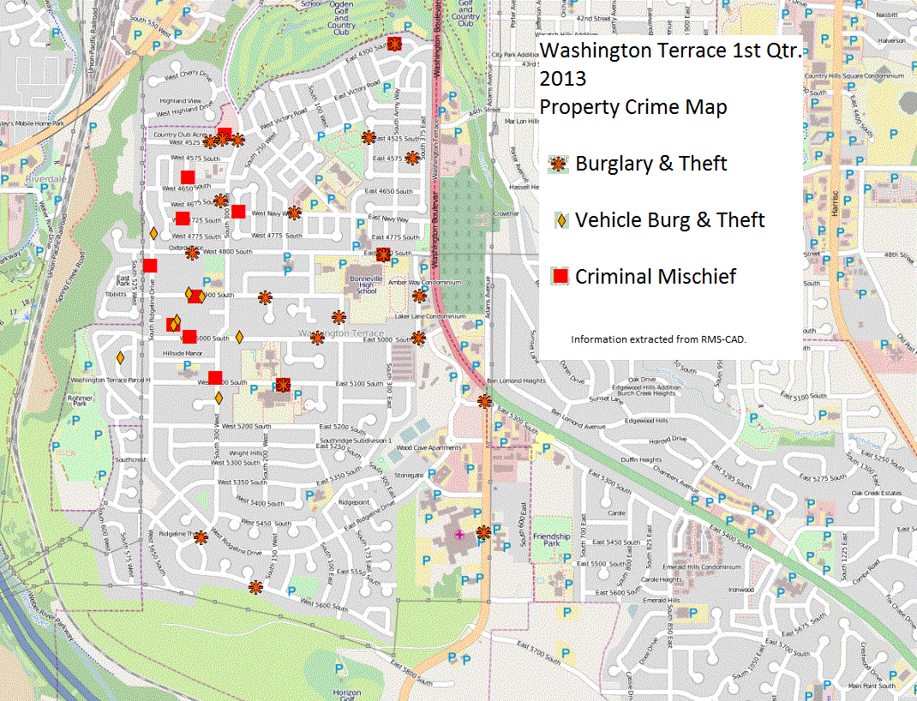

Slide 12
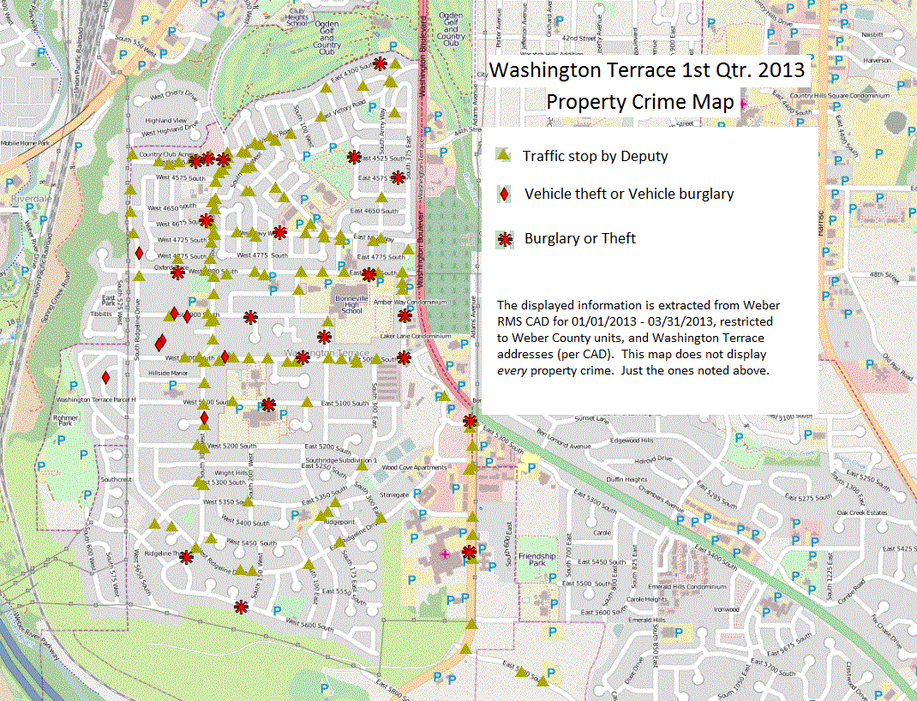

Slide 13
CRIME PATTERNS AND STRATEGIES
Overall, call volume has increased the first three months of 2013. This is not due to an increase in crime but rather an increase in community-oriented policing efforts which include school visits and business checks.
Overall, violent crime and property crime rates remain relatively low. Most of the vehicle burglaries and damaged property crimes are occurring between 300 W. to 500 W. and 4525 S. to 5100 S.
An increase in temperature usually correlates with an increase in property crimes.
A crime prevention letter will be sent out with the city newsletter reminding residents to always lock their vehicles and to never leave valuables inside.
Deputies will increase patrol in problem areas and continue to conduct more security checks, foot patrols and bicycle patrols.

Slide 14

BIKE PATROL
QUIET AND COVERT
ALLOWS FOR DETECTION THROUGH SIGHT AND SOUND
GREAT FOR RESIDENTIAL AREAS

Slide 15
COMMUNITY POLICING
Crime prevention letter to be mailed out with city newsletter.

Slide 16

SCHOOL VISITS
BONNEVILLE HS
Jan - 15
Feb – 12
MAR - 11
TH BELL JR HIGH
Jan – 6
Feb – 7
MAR -2
ROOSEVELT ELEMENTARY
Jan – 7
Feb – 4
MAR -5
WASHINGTON TERRACE ELEMENTARY
Jan – 10
Feb – 9
MAR -11

Slide 17
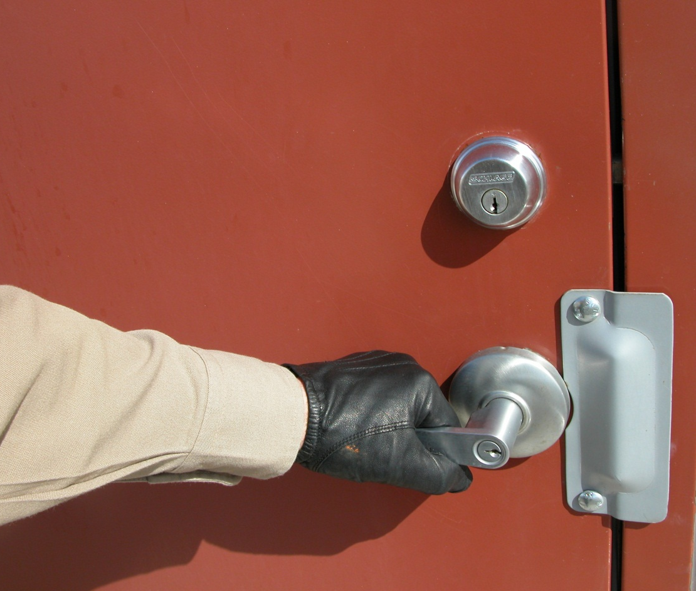
PREMISES CHECKS
JANUARY
56
February
31
MARCH
38

Slide 18
CALLS FOR SERVICE
10-year Comparison
  TOTAL CALLS
  2012 5919
  2011 6172
  2010 6847
  2009 6892
  2008 7060
  2007 7556
  2006 7632
  2005 7936
  2004 7571
  2003 8011

Slide 19
WRITTEN REPORTS
10-year Comparison
  REPORTS
  2012 2926
  2011 2629
  2010 2610
  2009 2632
  2008 3040
  2007 3402
  2006 3128
  2005 3304
  2004 3206
  2003 3913

Slide 20
TRAFFIC STOPS
10-year Comparison
  TOTAL Stops
  2012 921
  2011 1174
  2010 1741
  2009 1450
  2008 1571
  2007 1831
  2006 2145
  2005 2222
  2004 2081
  2003 2315

Slide 21
CITATIONS
10-year Comparison
  CITATIONS
  2012 1217
  2011 1106
  2010 1555
  2009 1450
  2008 1564
  2007 1747
  2006 1651
  2005 2021
  2004 1546
  2003 1270

Slide 22
BREAKING DOWN THE NUMBERS
The total number of calls for service has decreased 25% between 2003 and 2012.
The number of reports written has decreased 26% between 2003 and 2012.
The number of traffic stops has decreased 60% between 2003 and 2012.
The number of citations has fluctuated over a 10-year period of time with a high of 2021 citations in 2005 to a low of 1106 citation in 2011.

Slide 23
DV AND ASSAULTS

Slide 24
SEX AND DRUGS

Slide 25
PROPERTY CRIMES

Slide 26
WARRANTS & ARRESTS

Slide 27
WHY A DECREASE?
Increase in patrol presence
  The number of officers per shift more than tripled when the Sheriff’s Office took over the Terrace contract. Increased patrol equals a decrease in crime. A supervisor was also added to each shift to provide 24-hour coverage.
Specialty positions created
  Community resource officer, community resource division, two school resource officers, a DARE officer, full-time detective and traffic unit.
Problem-solving policing
  Problem residences, apartments and specific criminals were targeted. The Good Land Lord Program was created. These efforts helped reduce and eliminate crime.
Increased traffic enforcement
  Strict traffic enforcement was conducted. In addition to citations, many arrests were made for drugs, warrants and other offenses. The word got out, “Don’t speed in the Terrace!”
Reduction in force
  The elimination of specialty positions, deputy positions, and the consolidation of resources has reduced the number of deputies in the Terrace. The reduction of positions eliminates the opportunity for some problem-solving policing as deputies have less time to devote to these activities. Doing more with less means other responsibilities are also divided up.
Personnel changes
  Changes in personnel can sometimes affect crew chemistry and overall production.

Slide 28
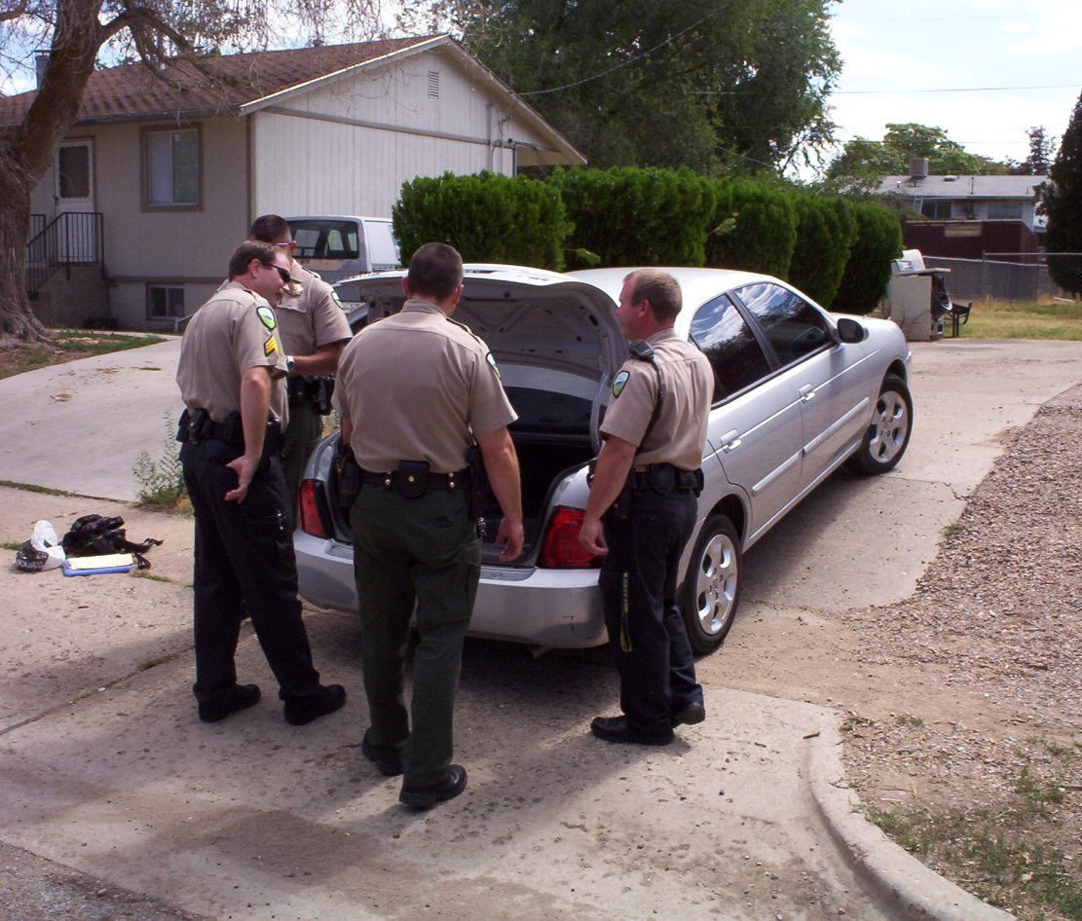
PROBLEM SOLVING POLICING
Identify
ANALYSIS
RESPONSE
ASSESSMENT

Slide 29
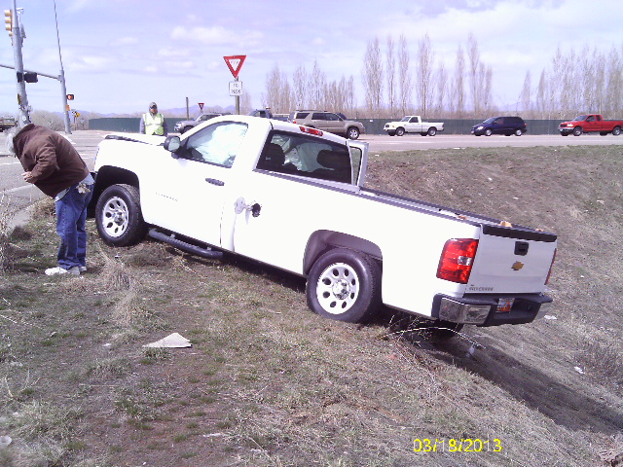
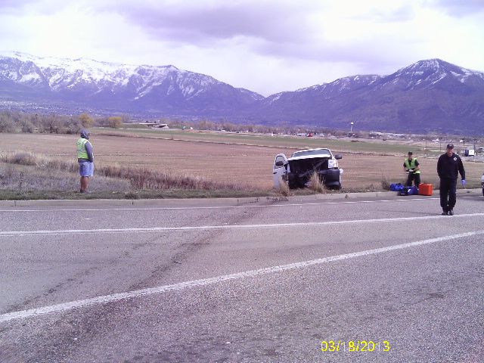
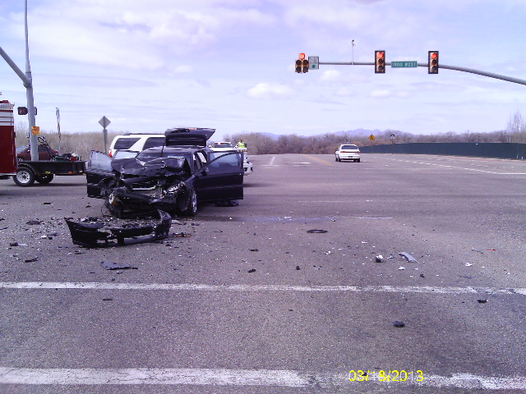
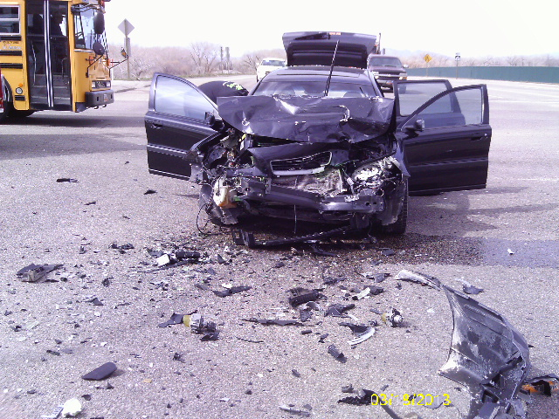
Multiple CALLS =
Multiple RESPONSES
03/18/2013
1229 hours
1900 W. 12th St.
4 deputies
1237 hours
1300 W. 12th St.
3 deputies
1238 hours
1670 W. 12th St.
3 deputies

Slide 30
PRIORTY CALLS =
MULTIPLE OFFICERS
On 03/07/13 at 1126 hours, deputies responded on a burglary-in-progress at 310 W. 4675 S. A male suspect had broken into this home and then fled in a vehicle. Deputies stopped the vehicle a few blocks away while other deputies went to the residence. Drugs were found inside the suspect’s vehicle. Detectives responded out and took the suspect to the Sheriff’s Office where he confessed to the crime.
DEPUTIES ON SCENE
Lieutenant Burns SRO Lemberes
Deputy Christensen SRO C. Allen
Deputy A. Allen Detective Kelly
CRO McDonald Detective Follum
TOTAl = 8

Slide 31
BONNEVILLE HIGH SCHOOL
THE CITY WITHIN THE CITY
  TOTAL CALLS
  2008 443
  2009 378
  2010 257
  2011 192
  2012 234

Slide 32
BONNEVILLE BREAKDOWN
5-YEAR COMPARISON

Slide 33
TRENDS
CAD CALL REPORT FOR WASHINGTON TERRACE
FIRST QUARTER
 | ALL | WC | WC | WC | WC | WC | WC | WC | WC | WC | WC | WC | Calculated via TREND function
 | 2002 | 2003 | 2004 | 2005 | 2006 | 2007 | 2008 | 2009 | 2010 | 2011 | 2012 | 2013 | 2014
# of calls | 1428 | 1975 | 1808 | 1870 | 1762 | 1794 | 1551 | 1581 | 1676 | 1391 | 1444 | 1707 | 1520
On-view calls | 493 | 894 | 791 | 905 | 781 | 759 | 633 | 615 | 757 | 501 | 451 | 768
% change |  | 81% | -12% | 14% | -14% | -3% | -17% | -3% | 23% | -34% | -10% | 70%
Non-officer generated | 935 | 1081 | 1017 | 965 | 981 | 1035 | 918 | 966 | 919 | 890 | 993 | 939 | 923
% change |  | 16% | -6% | -5% | 2% | 6% | -11% | 5% | -5% | -3% | 12% | -5% | -2%

Slide 34
PROACTIVE = PREVENTION

